Slide 1


LISTENING TO
DARK MATTER

Slide 2
BUT...
WHY BOTHER?

Slide 3
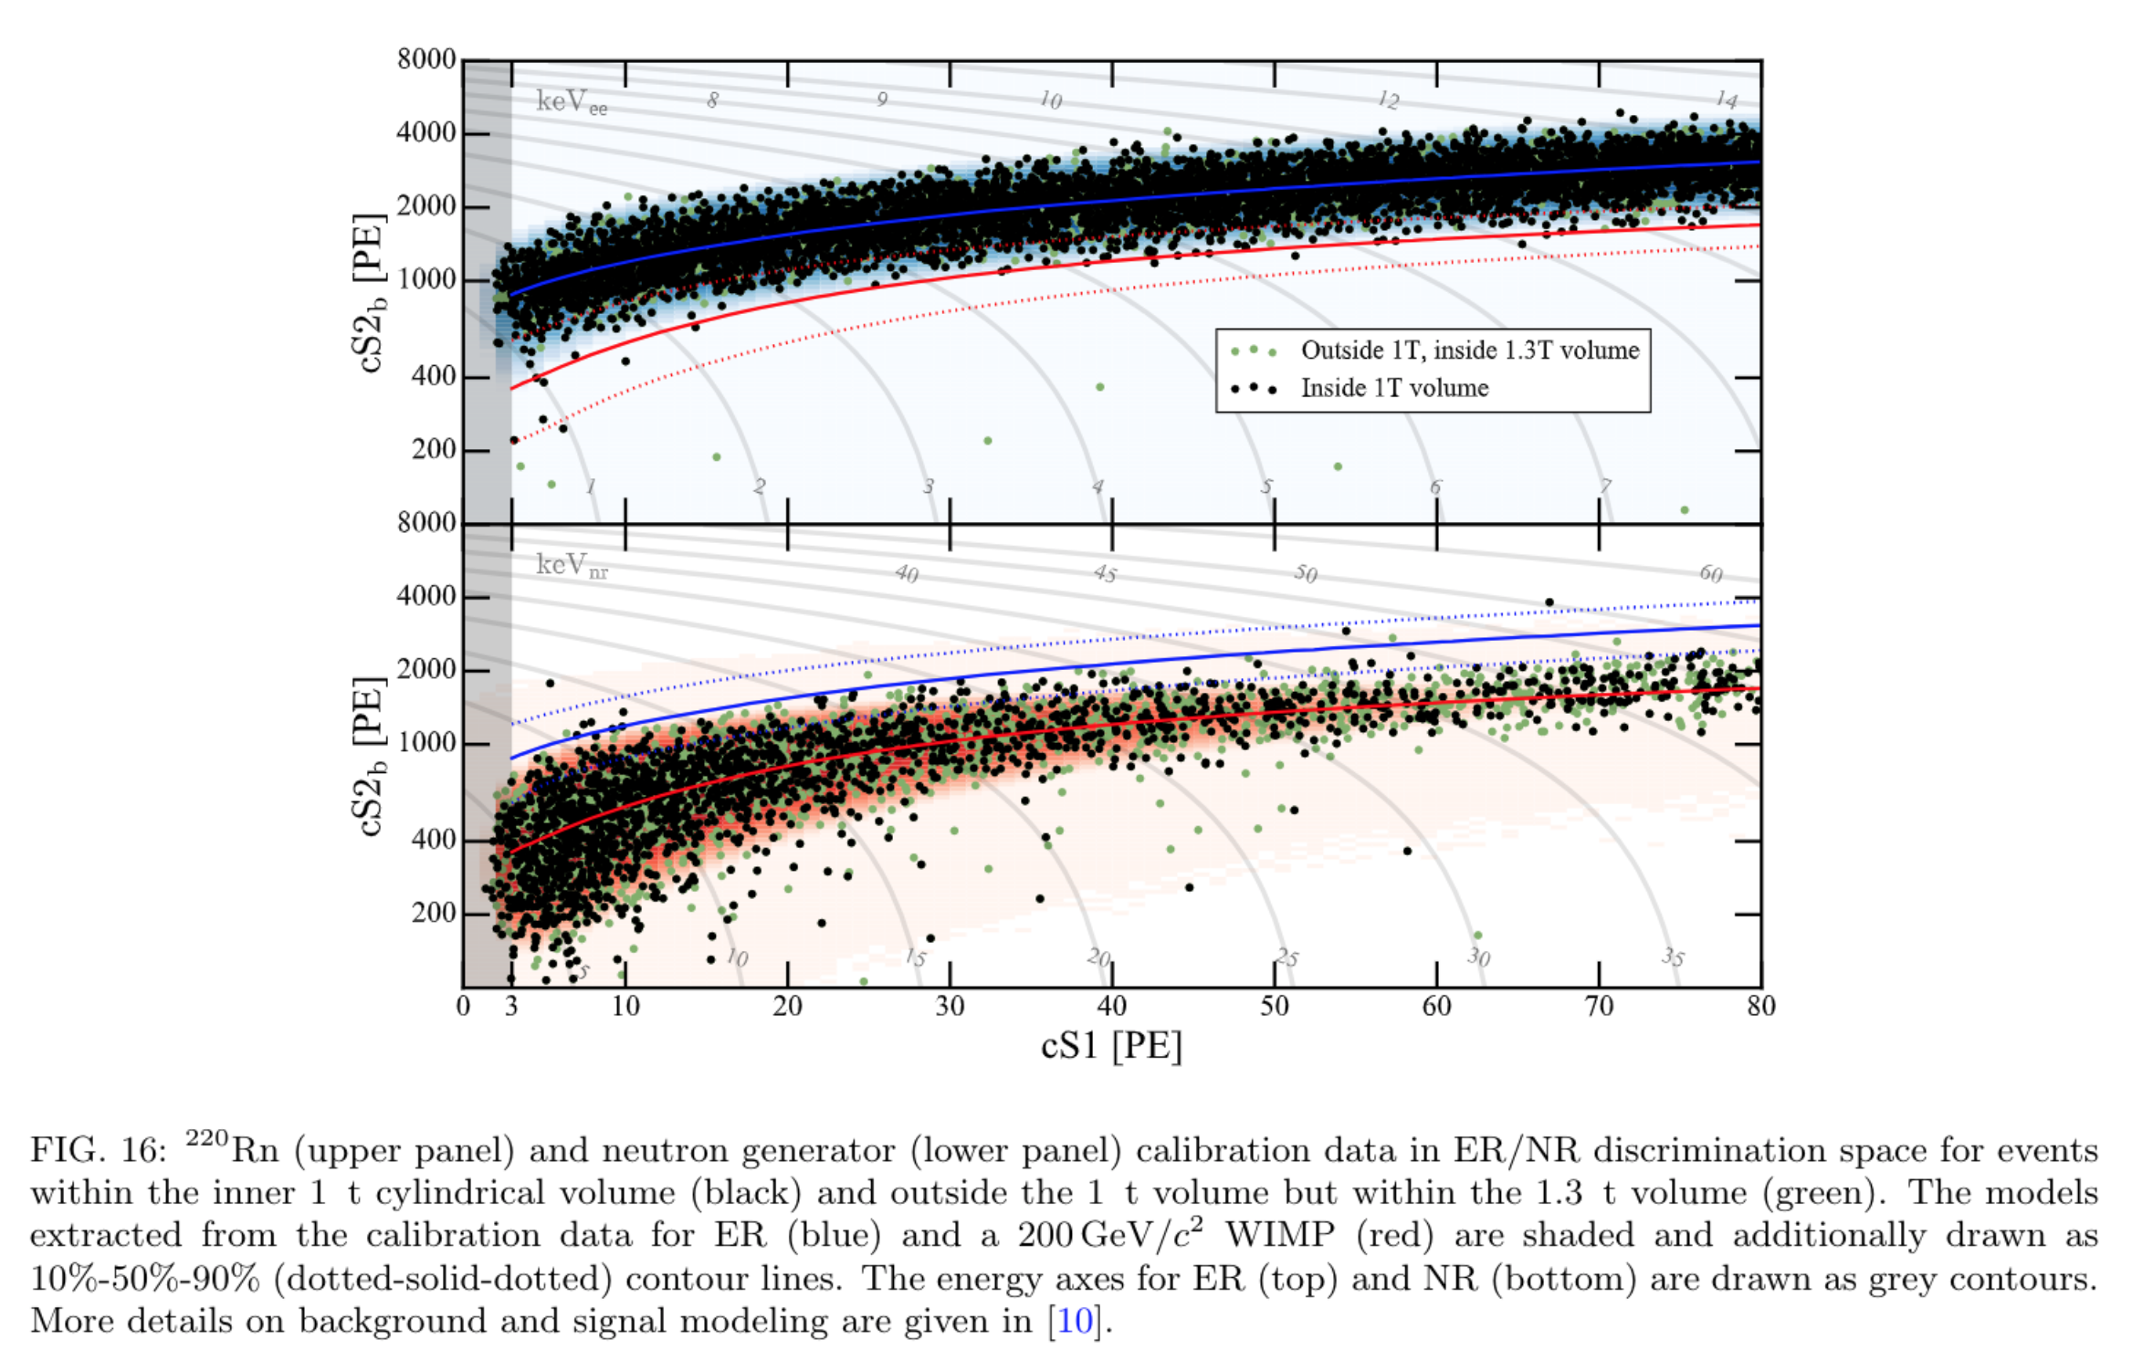

Aprile, E. et al., “XENON1T dark matter data analysis: Signal reconstruction, calibration, and event selection”, Physical Review D, vol. 100, no. 5, 2019. doi:10.1103/PhysRevD.100.052014.

Slide 4
SO… WHAT NOW?
NEW DETECTION CHANNEL!
Phonons
φ

Slide 5




EASY
IN SOLIDS
HARD
IN LIQUIDS
φ
Phonons
CRESST
EDELWEISS
SuperCDMS
Particles of Sound
PICASSO
PICO
Superfluid He
High Energy ν

Slide 6


HOW DO WE
DESCRIBE PHONONS?

Slide 7







HOW DO WE
DECAY / DAMPING?

Slide 8

HOW DO WE
DESCRIBE PHONONS?

Slide 9



HOW DO WE
DESCRIBE PARTICLES?
STEP 1:
HEAT CREATES SOUND

Slide 10


HOW DO WE
DESCRIBE PARTICLES?
STEP 2:
ENERGY DEPOSITED
Green, Dan. The Physics of Particle Detectors (Cambridge Monographs on Particle Physics, Nuclear Physics and Cosmology). United Kingdom, Cambridge University Press, 2000.

Slide 11


HOW DO WE
DESCRIBE PARTICLES?
STEP 3:
SPATIAL DISTRIBUTION
Red > 0, Blue <0, Alpha: |ε|

Slide 12

HOW DO WE
DESCRIBE PHONONS?

Slide 13
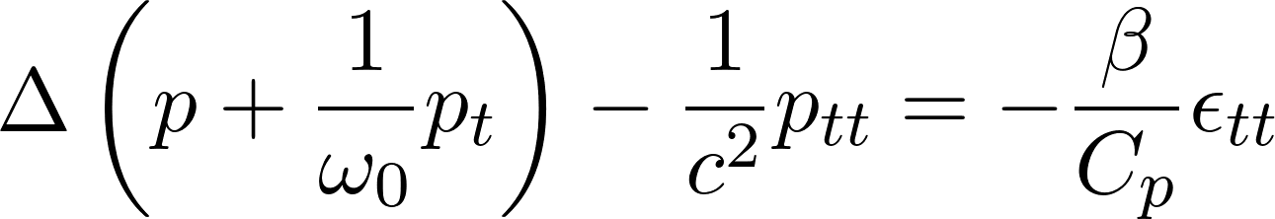
HOW DO WE
STUDY PHONON DECAY?

Slide 14
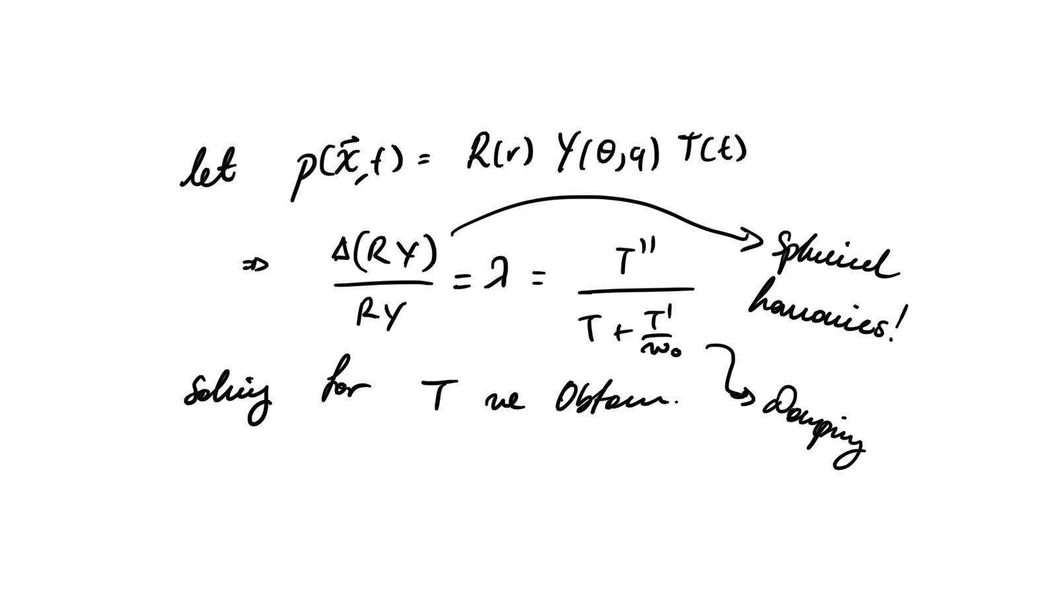
WE STUDY
SPHERICAL HARMONICS

Slide 15
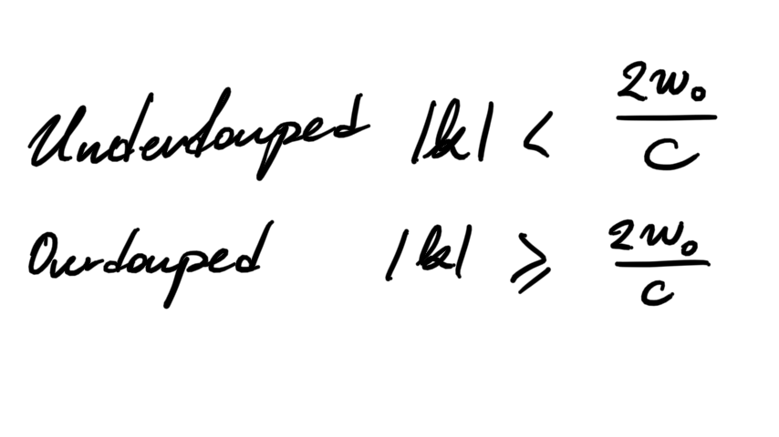

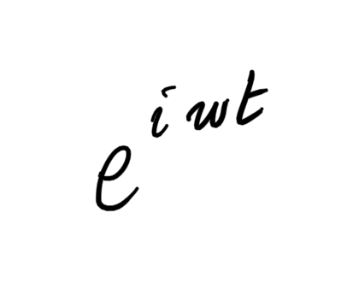
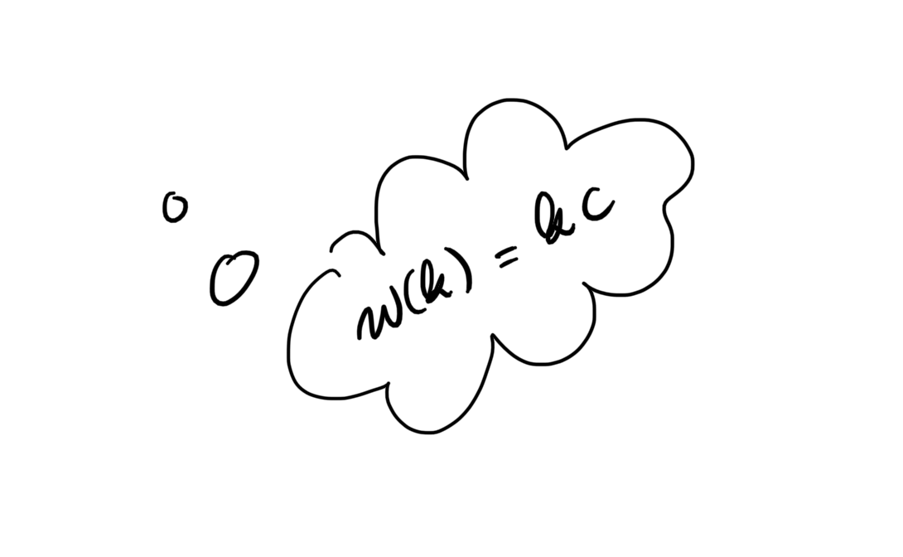

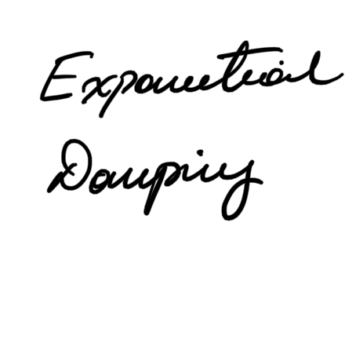
WE STUDY
SPHERICAL HARMONICS

Slide 16
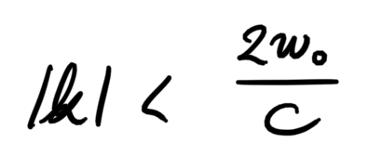
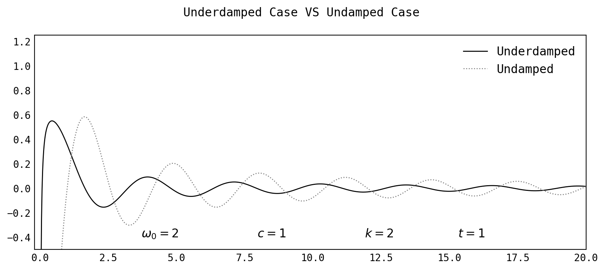
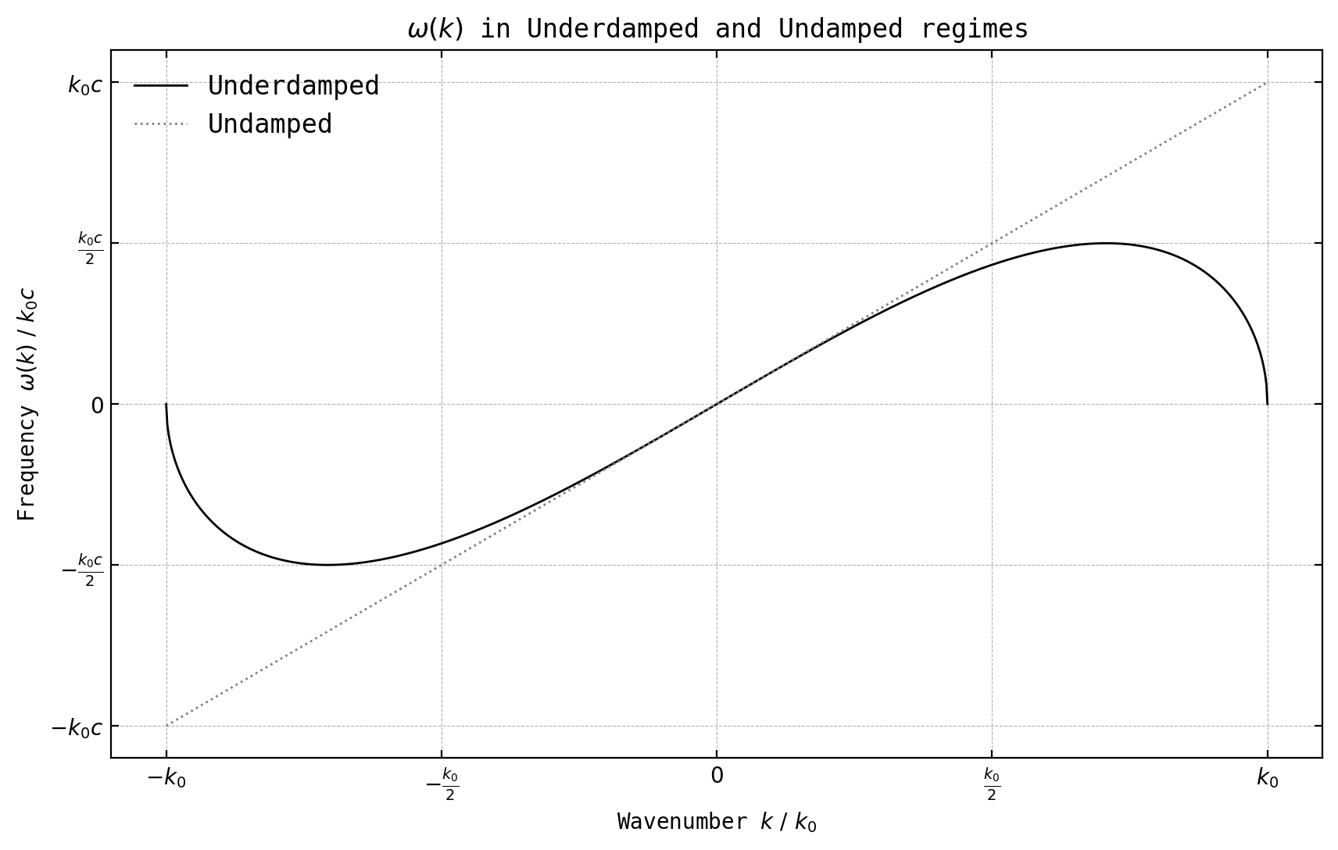
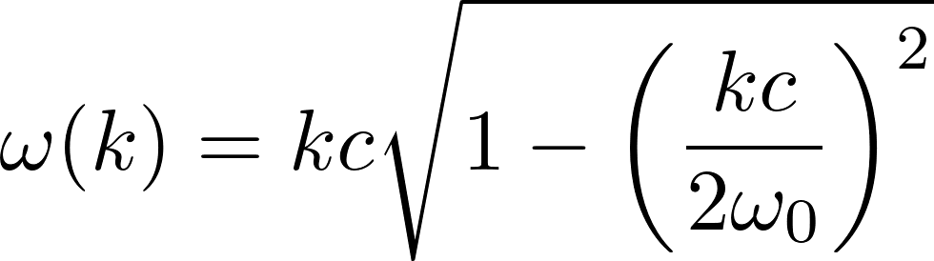
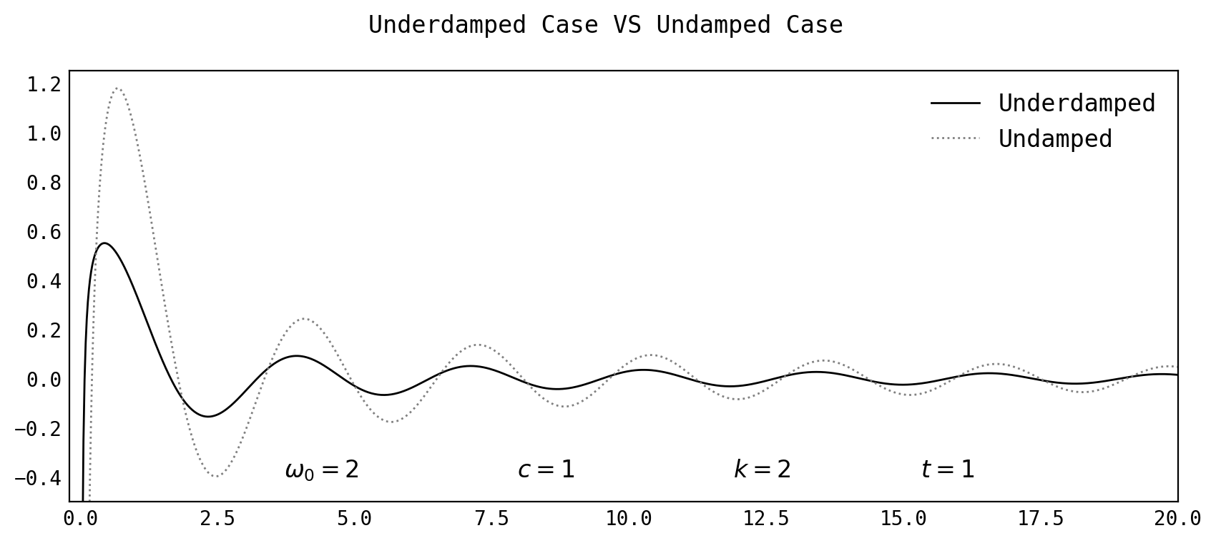
WE STUDY
UNDERDAMPED REGIME

Slide 17
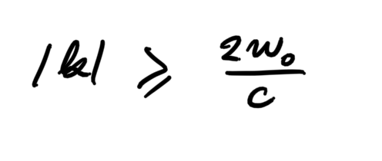
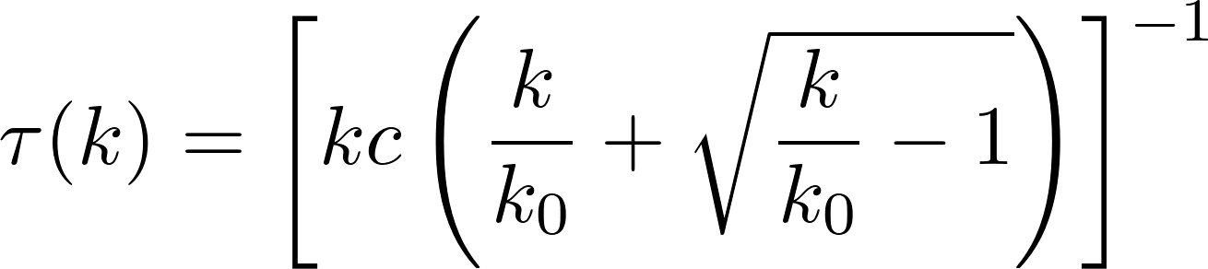
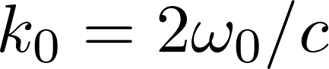
WE STUDY
OVERDAMPED REGIME

Slide 18
WE STUDY
SPHERICAL HARMONICS

Slide 19
WE STUDY
FUNDAMENTAL SOLUTION

Slide 20
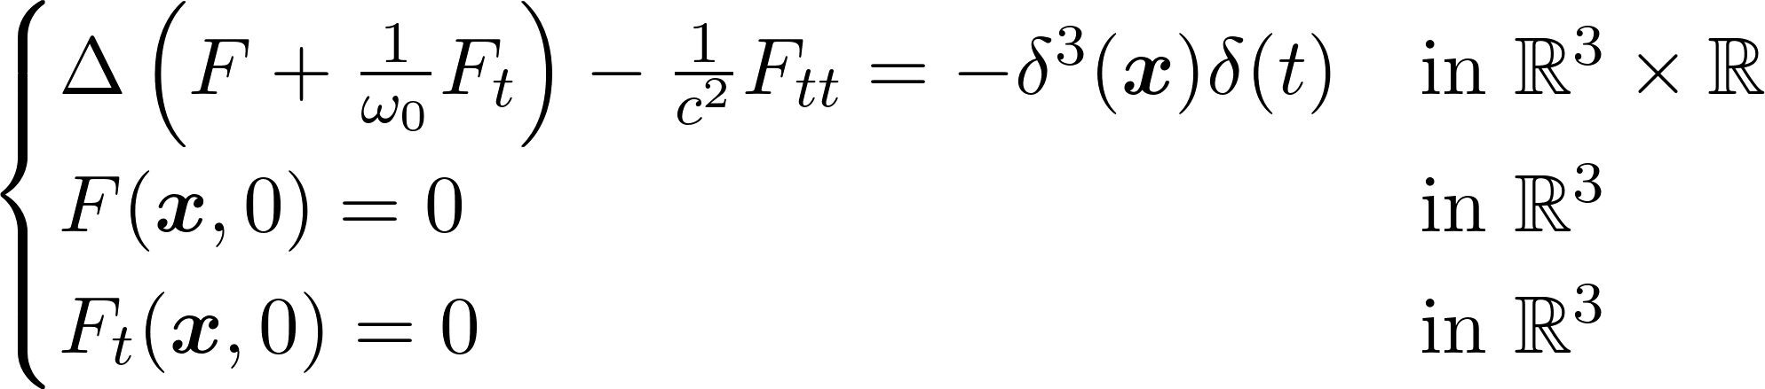
WE STUDY
FUNDAMENTAL SOLUTION

Slide 21
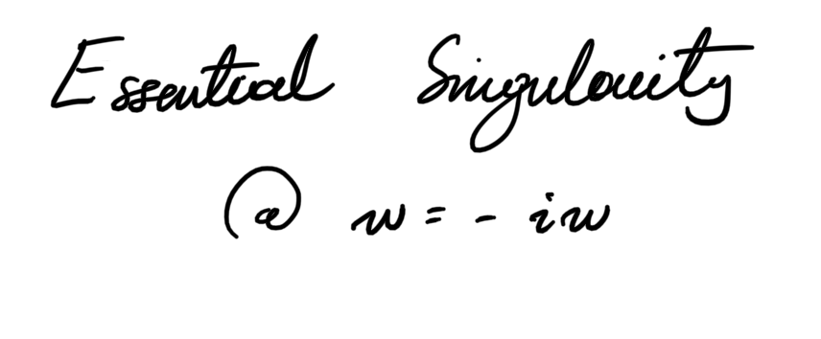

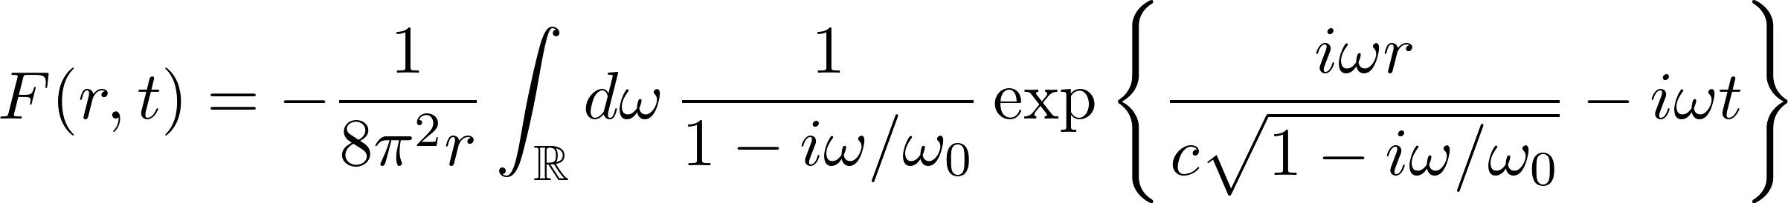

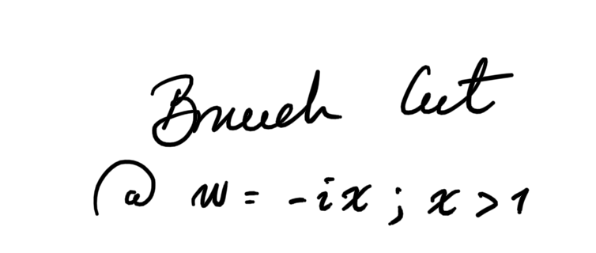
WE STUDY
FUNDAMENTAL SOLUTION

Slide 22
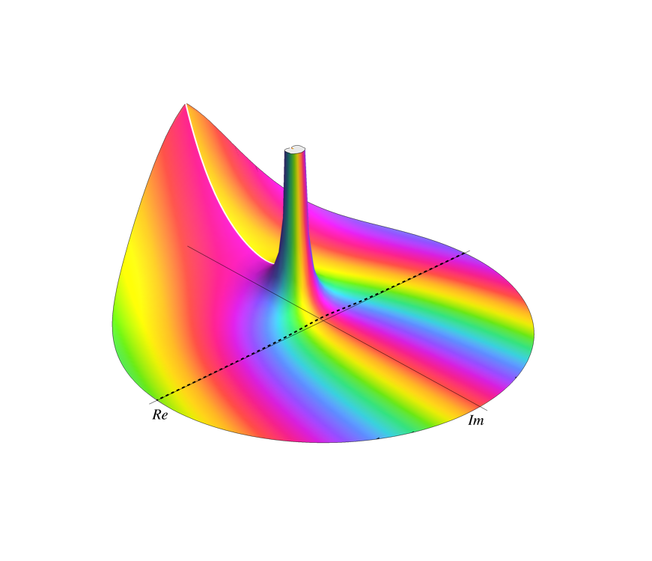
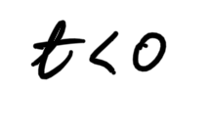

WE STUDY
FUNDAMENTAL SOLUTION

Slide 23
WE DESCRIBED
NOW WHAT?

Slide 24
NOW WHAT?
NUMERICAL ESTIMATION

Slide 25
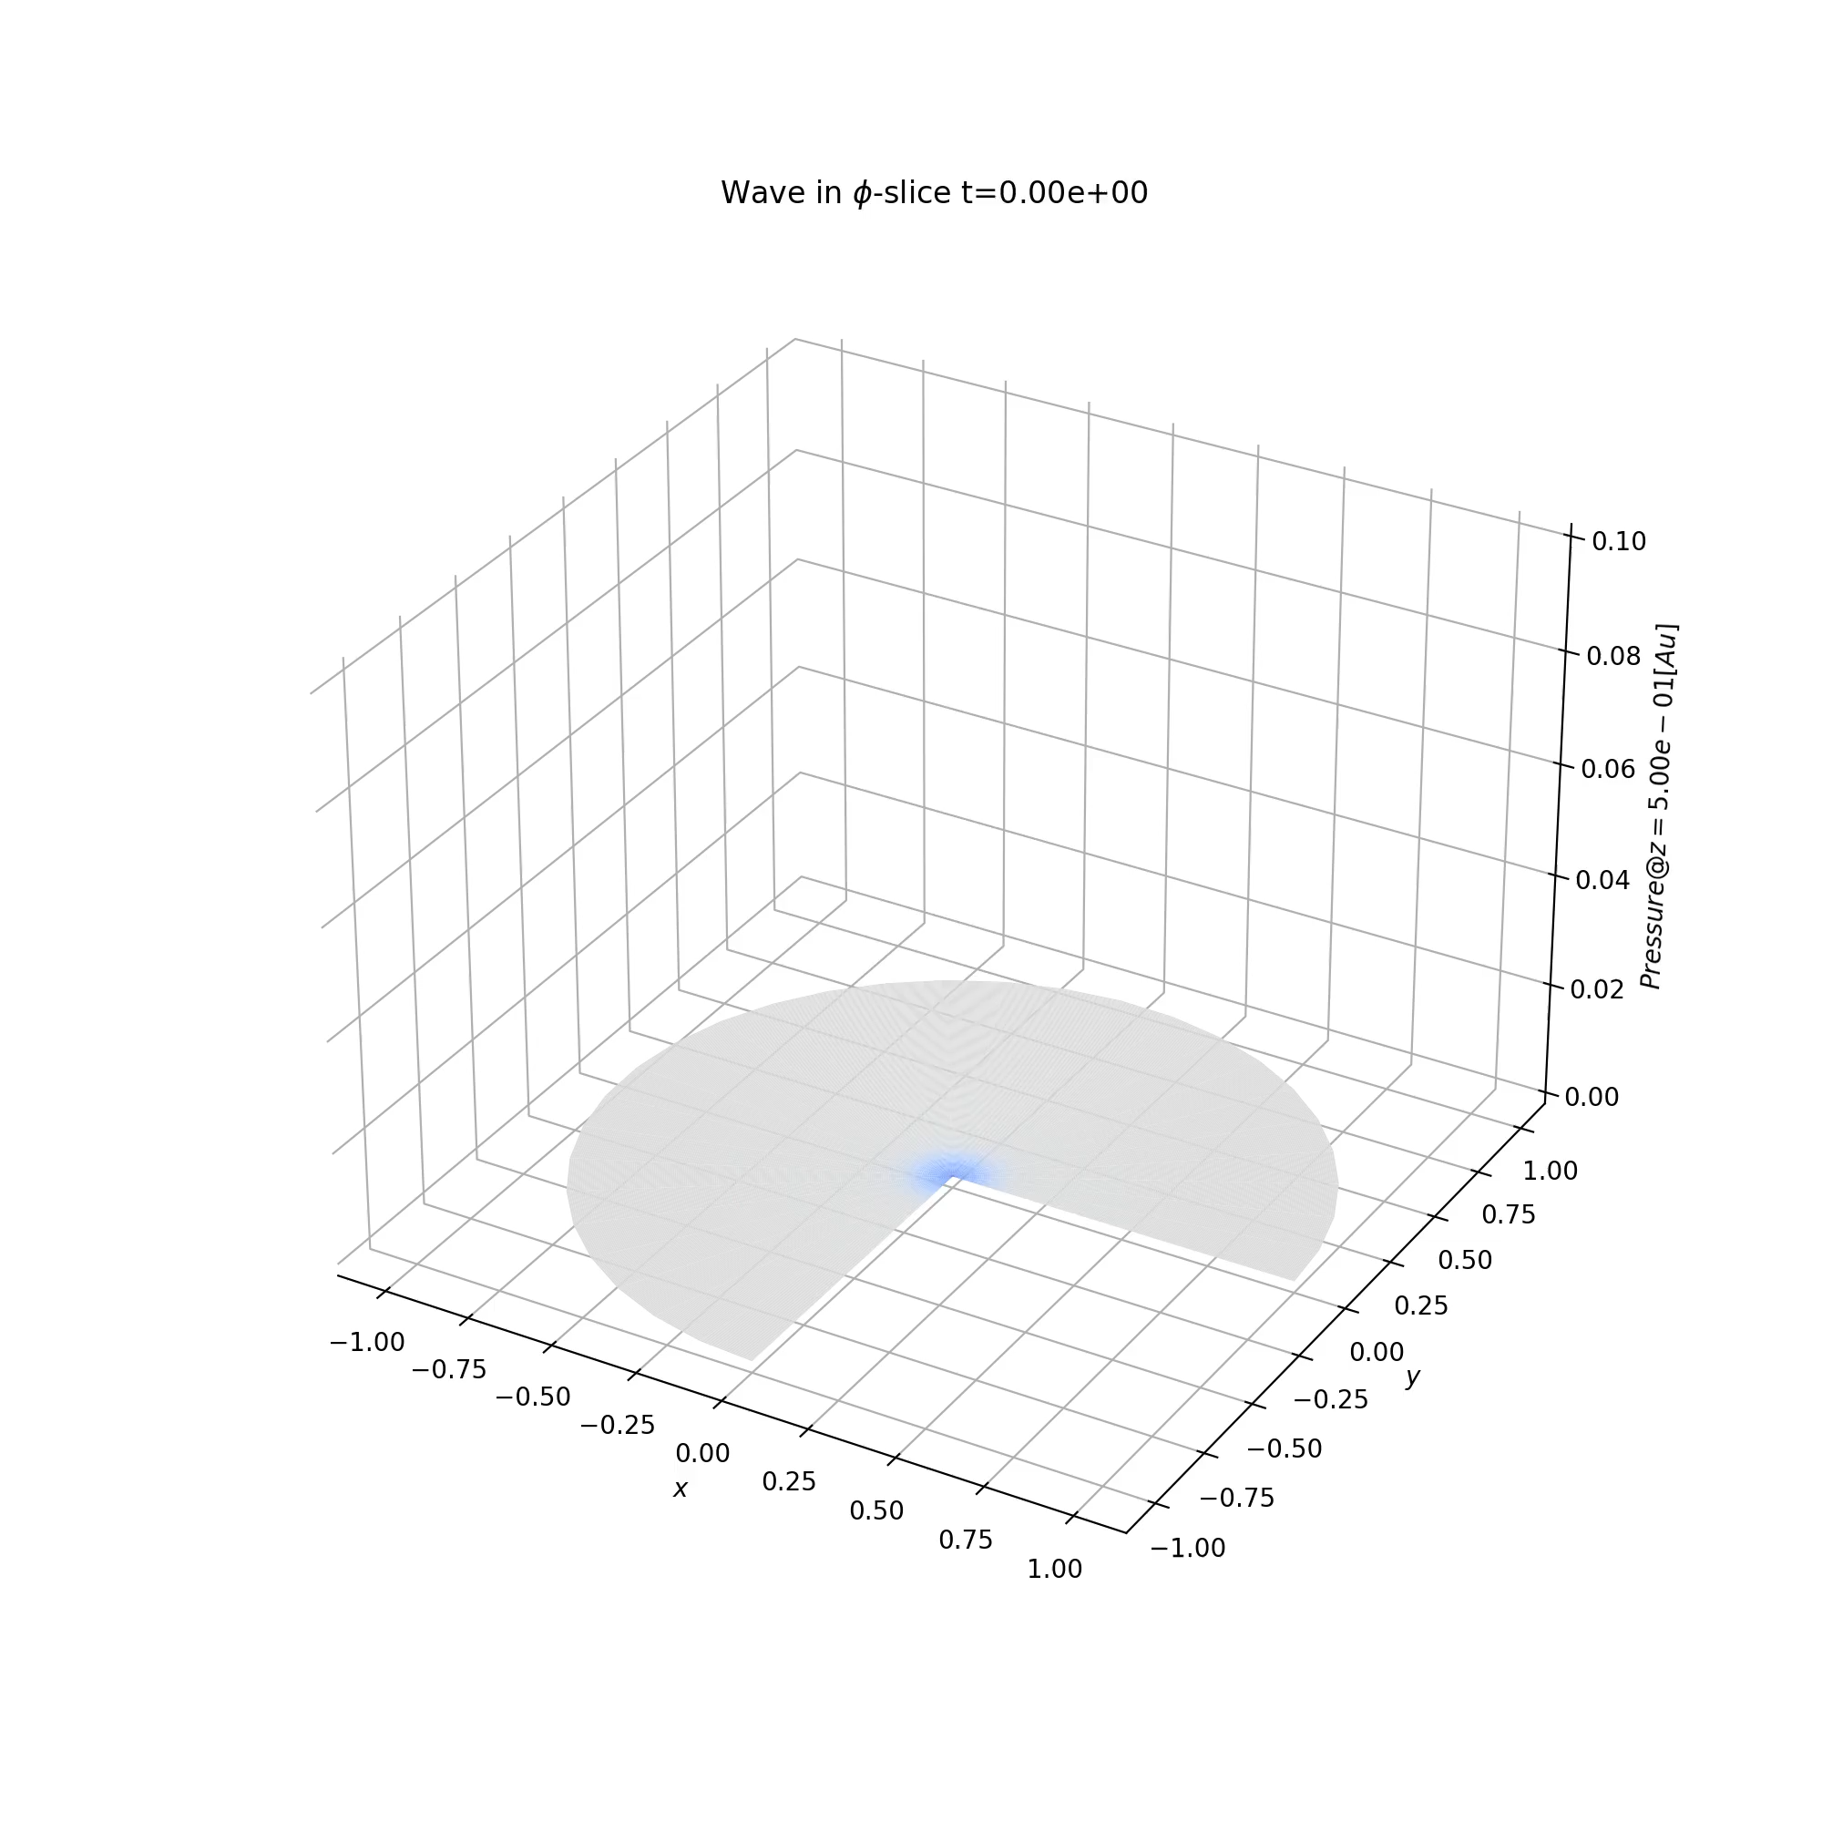
NUMERICAL ESTIMATION
WHAT’S TO COME
ACKNOWLEDGMENTS
Professor Francesco Arneodo (NYUAD)
Dr. Laura Manenti (NYUAD)
Professor John Learned (UHM)
Dr. Mario Motta (CALTECH)
Professor Elena Beretta (NYUAD)
Professor Francesco Paparella (NYUAD)
Lucas Sletten (UCB)

Slide 26
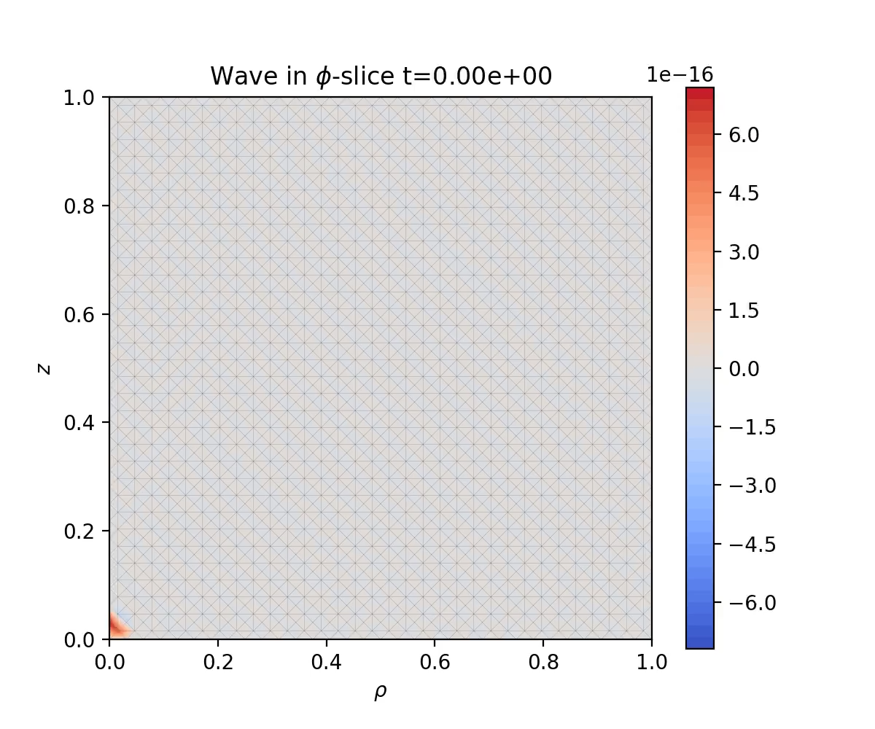
NUMERICAL ESTIMATION
WHAT’S TO COME
QUESTIONS?

